Slide 1



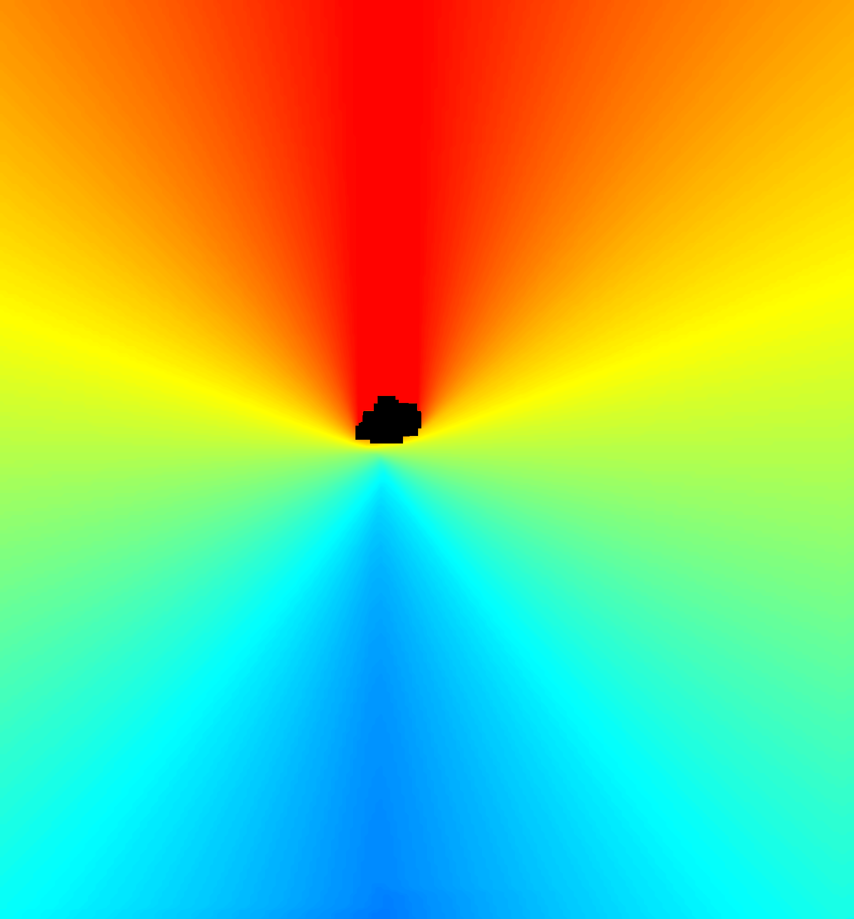
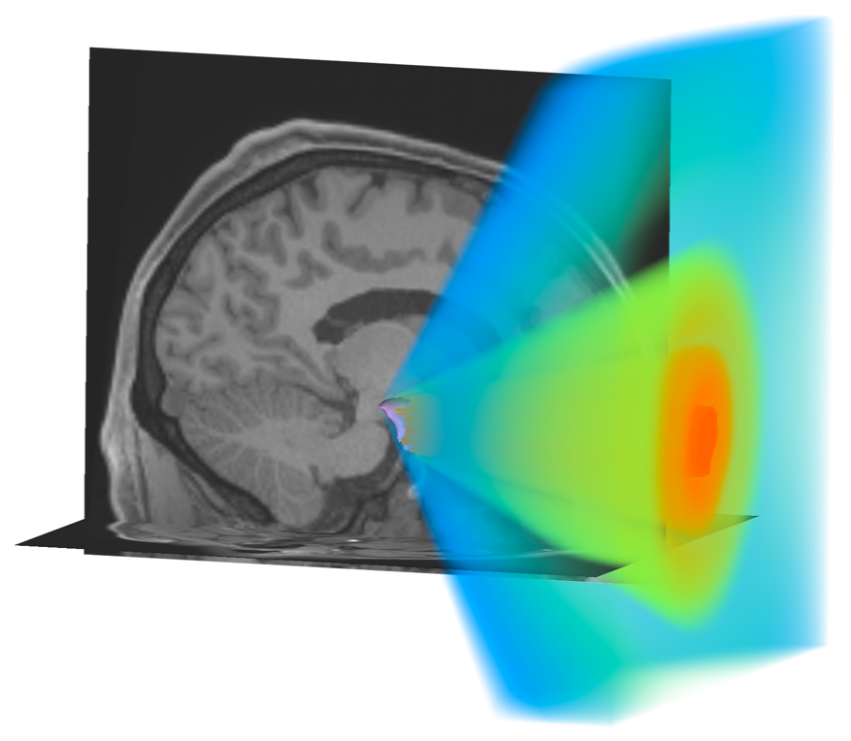
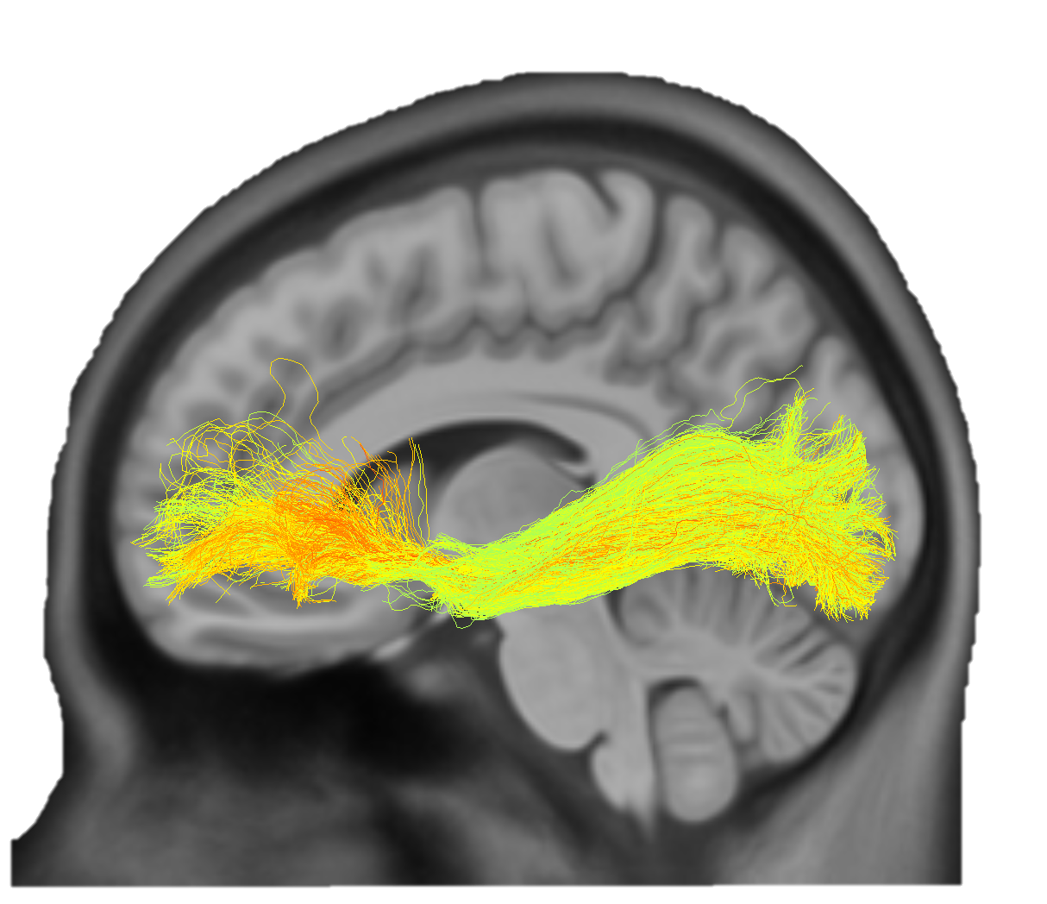
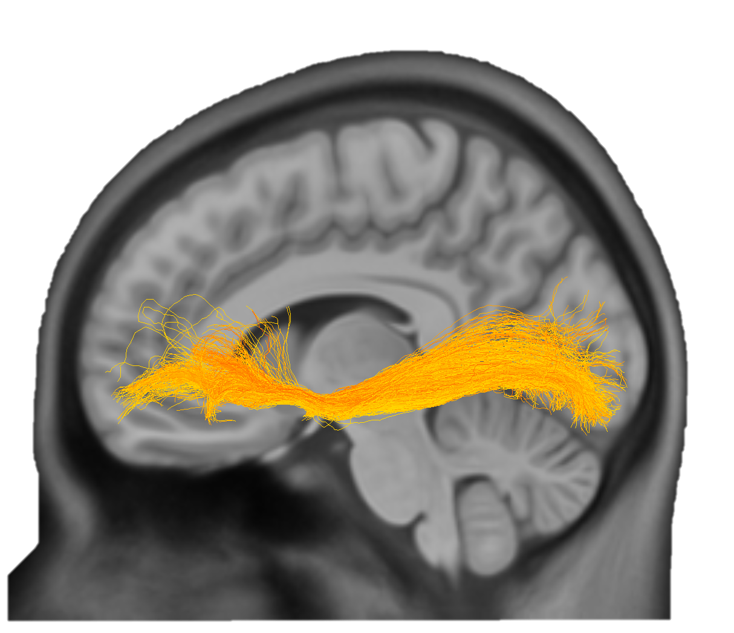
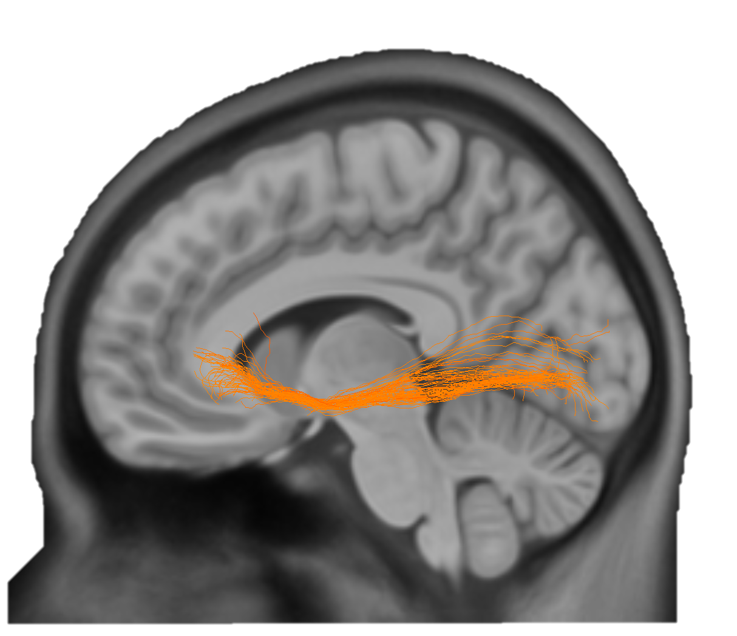
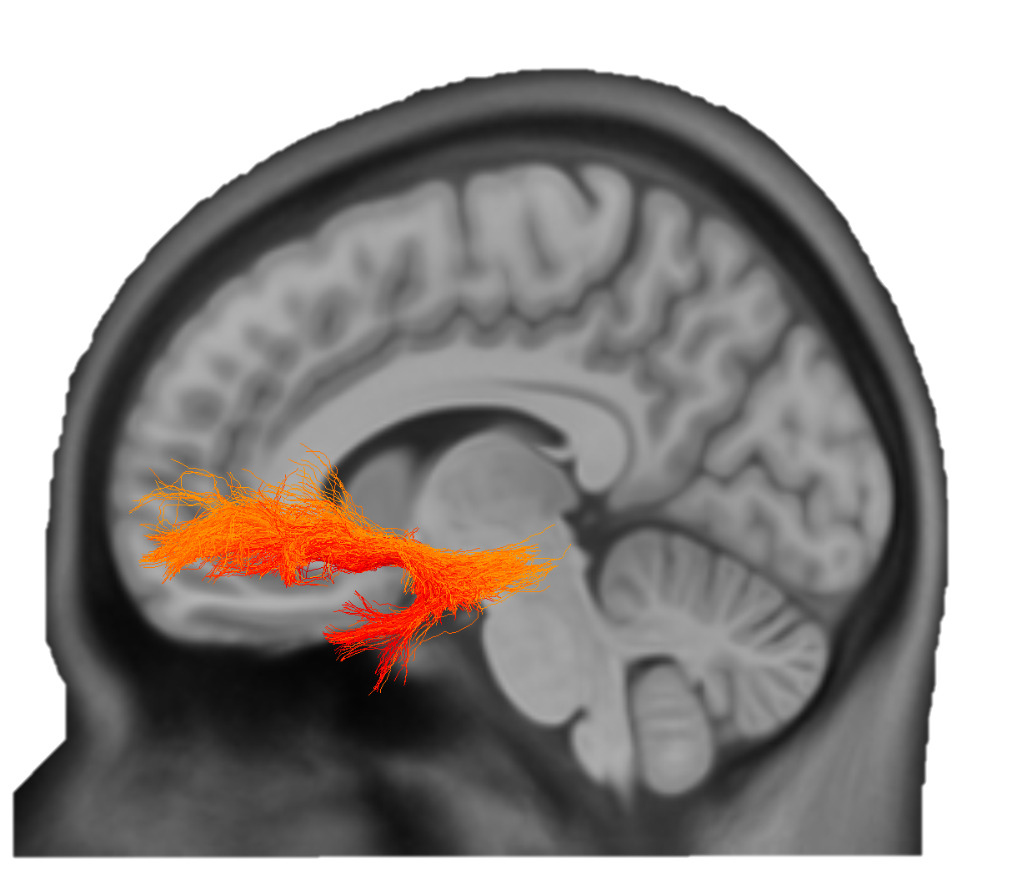
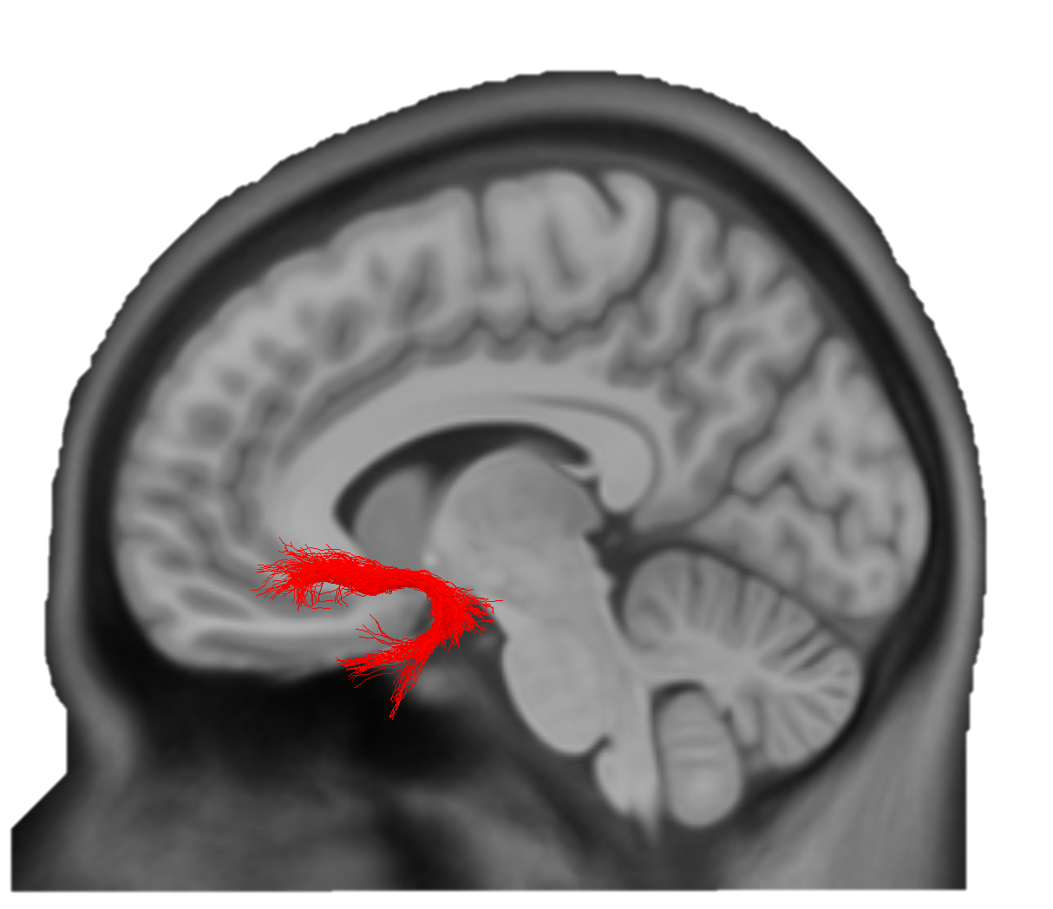

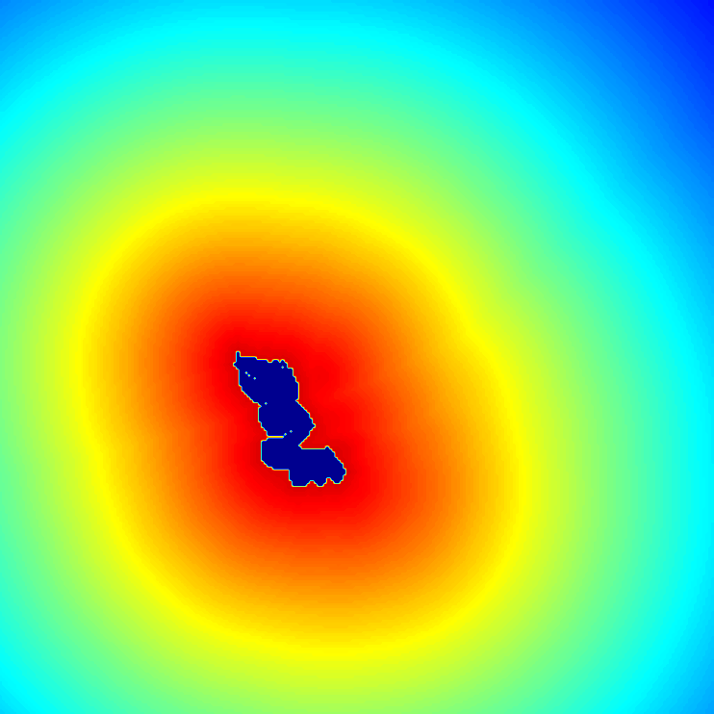
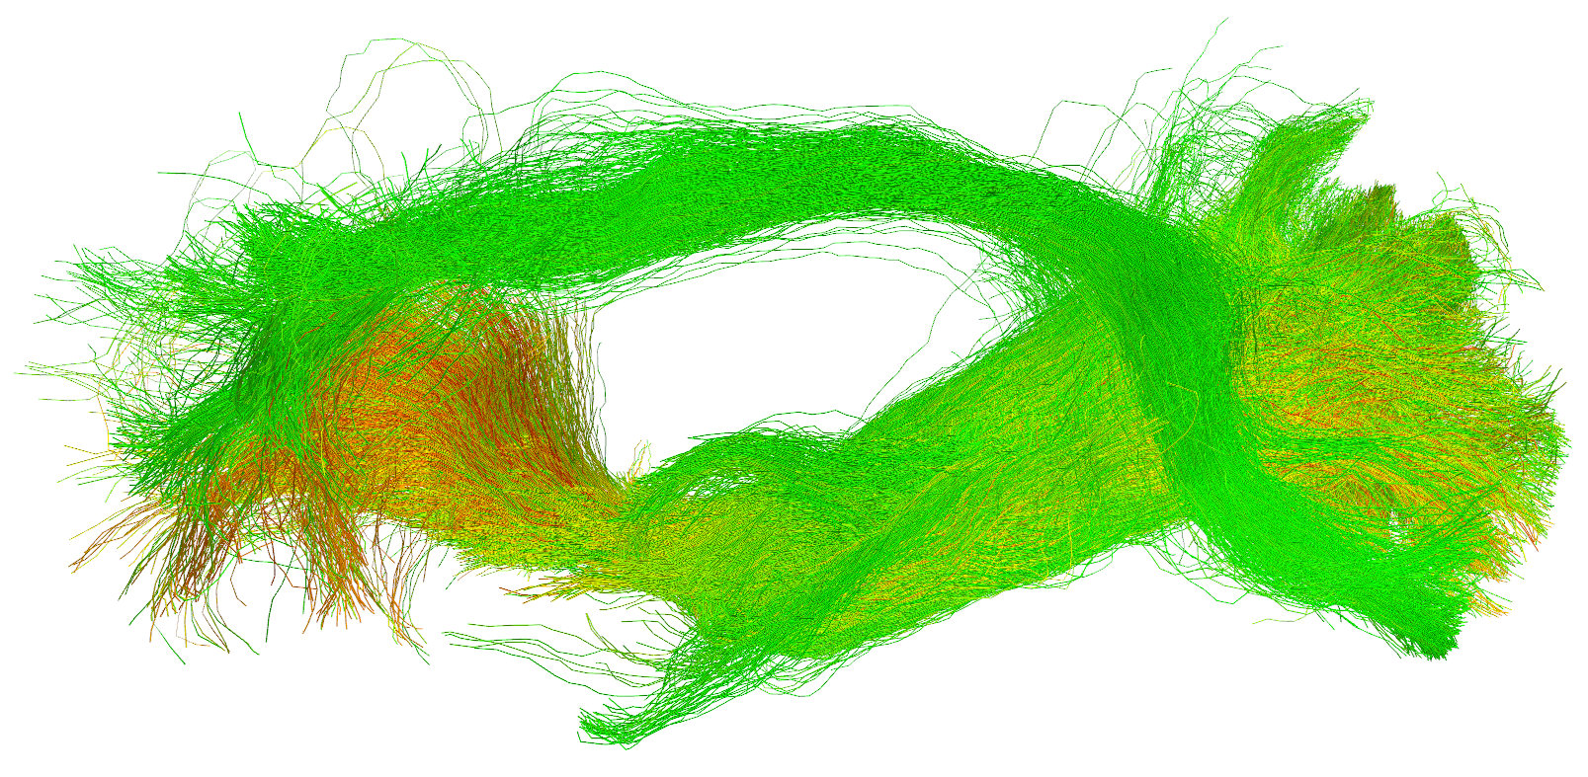
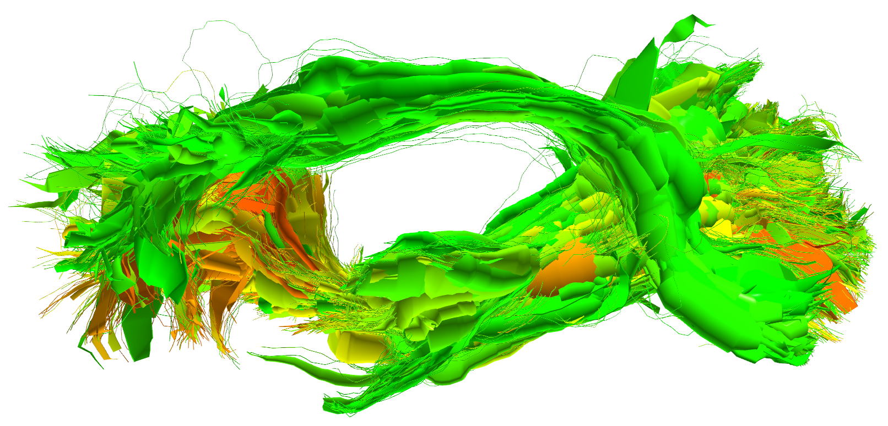
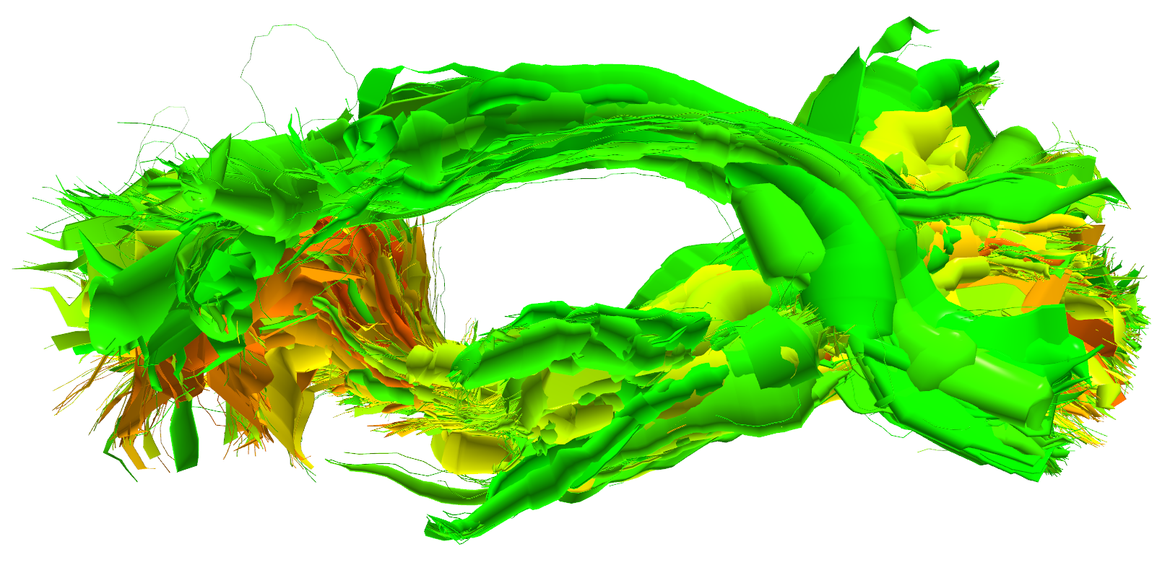
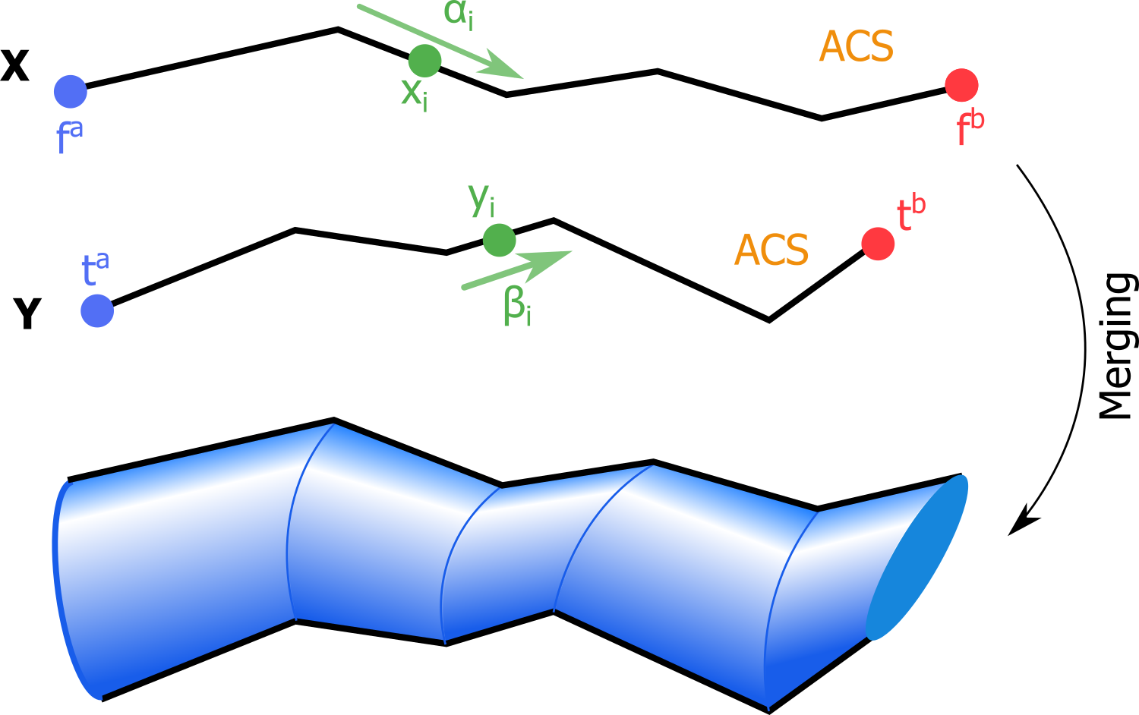
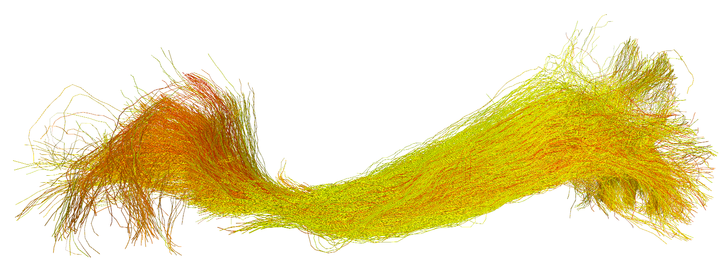
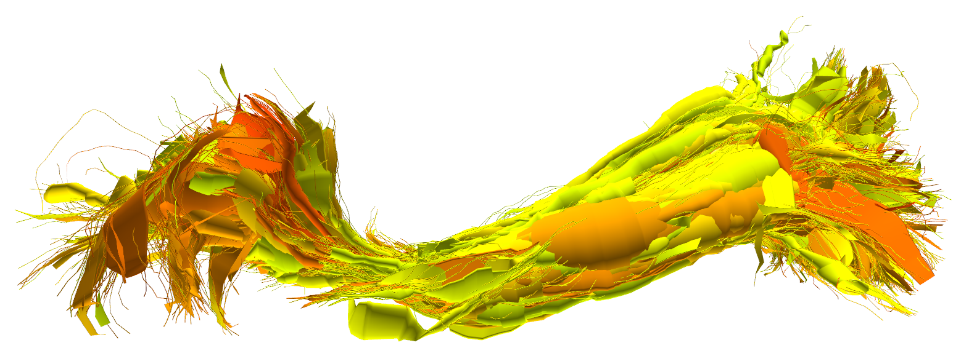
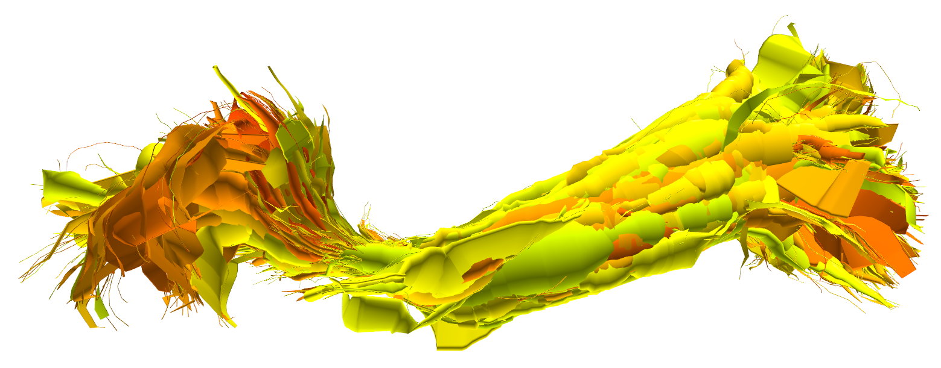
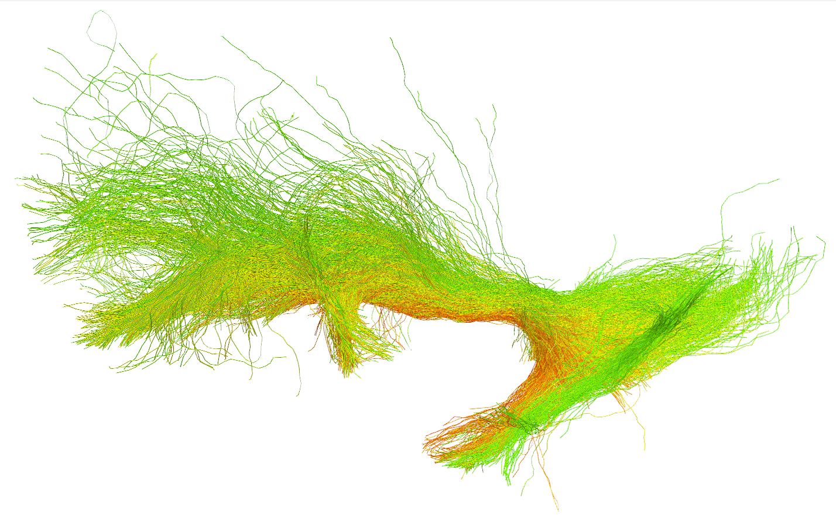
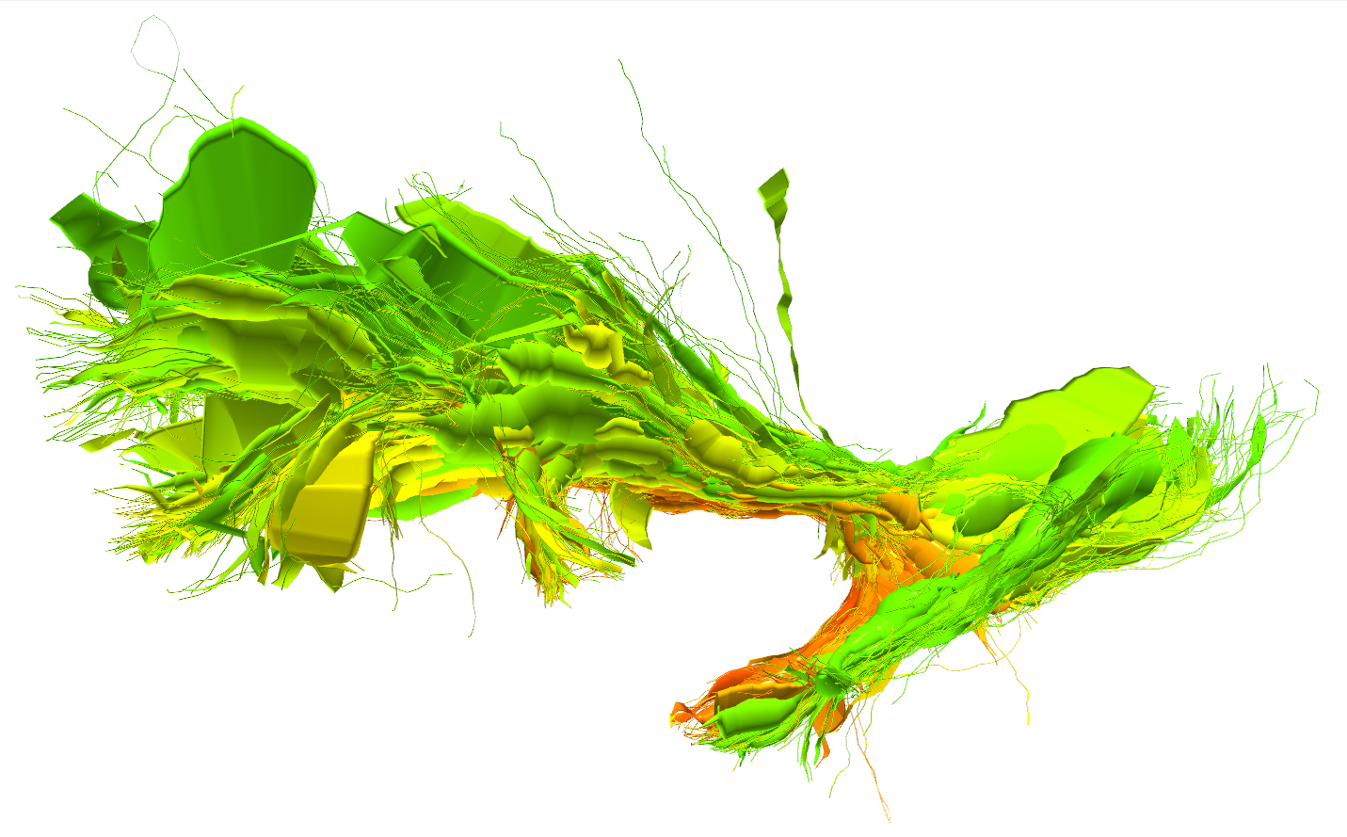
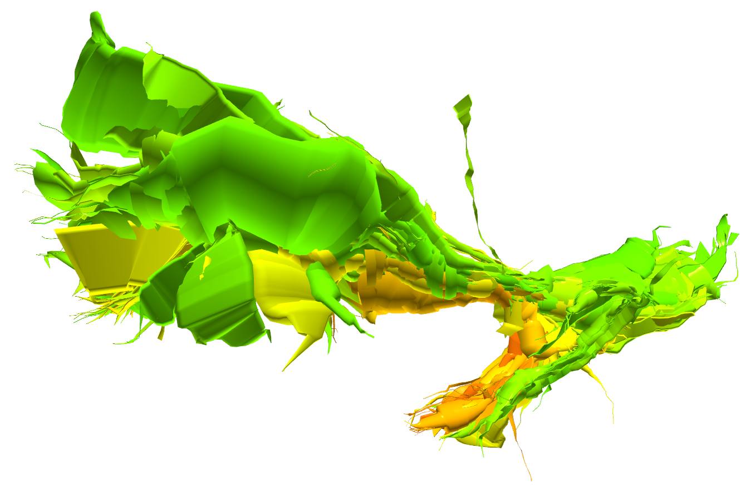
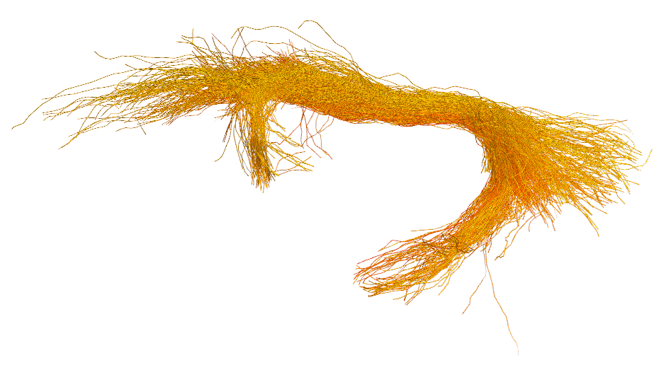
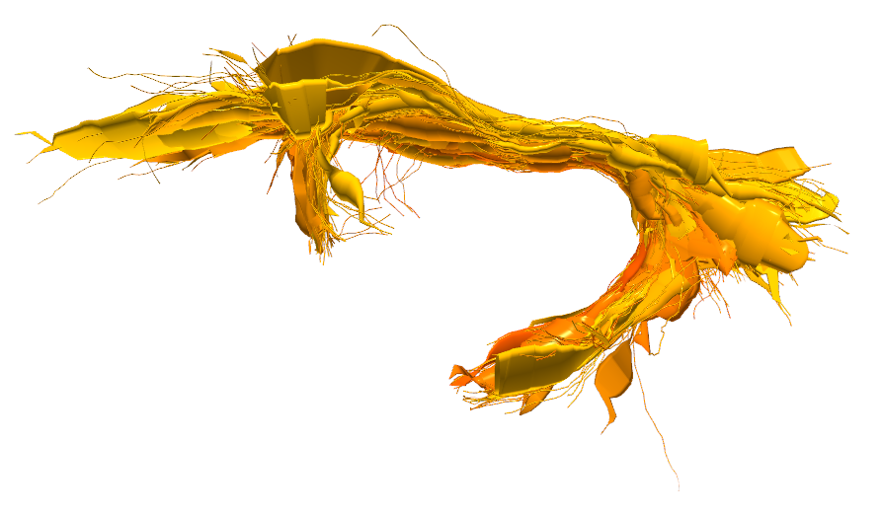
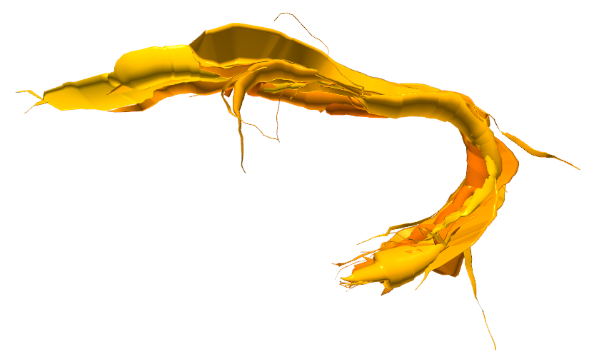
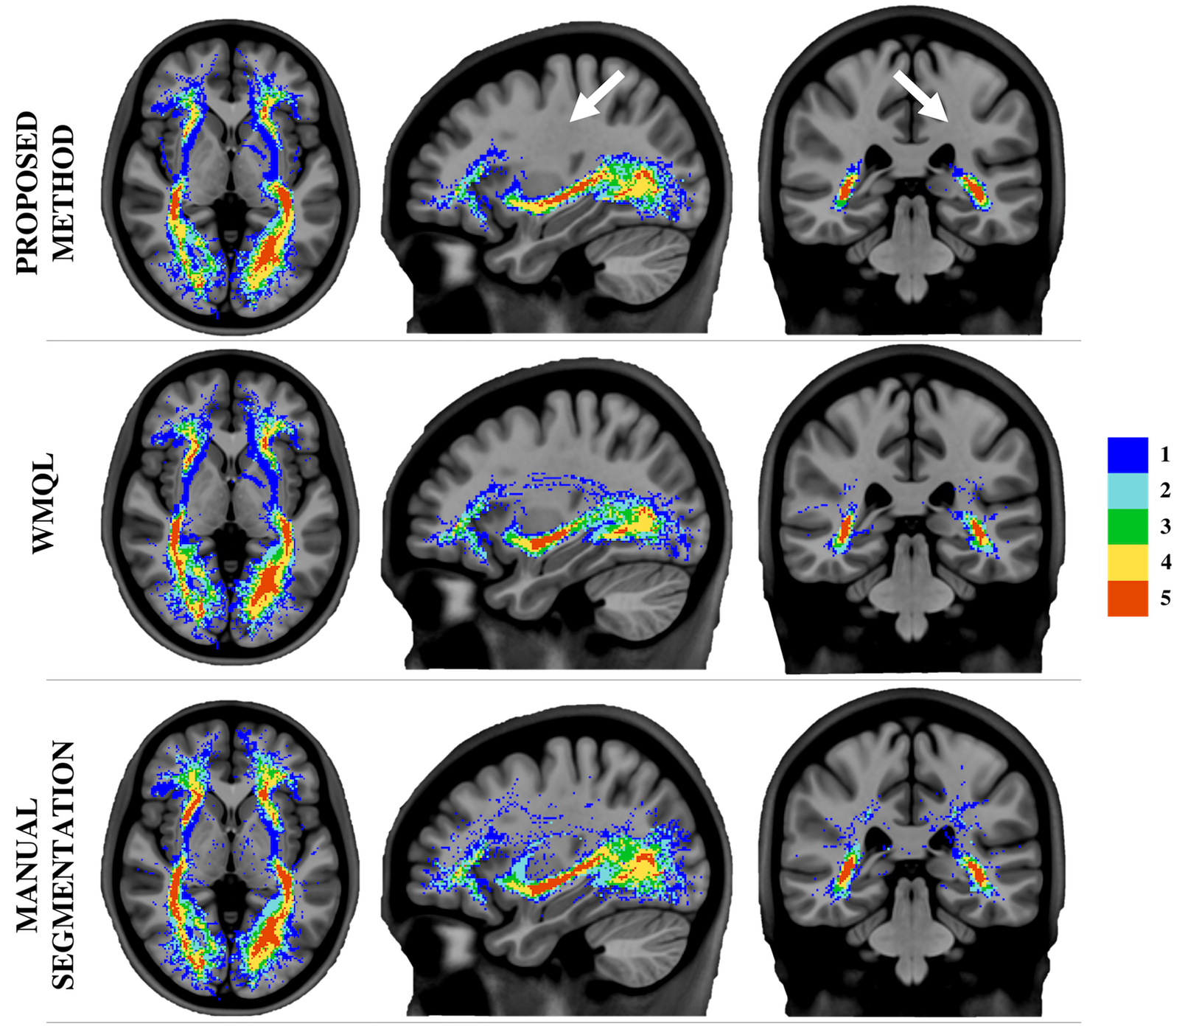






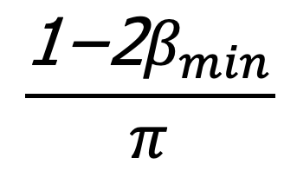
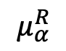
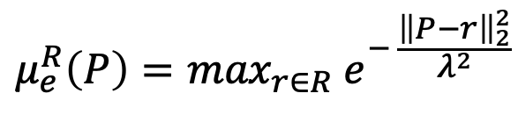

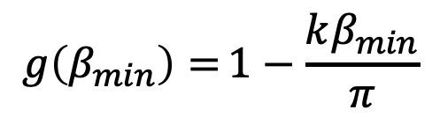
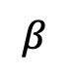
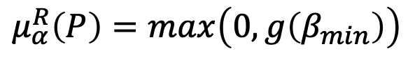
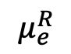
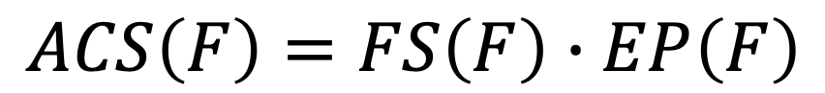
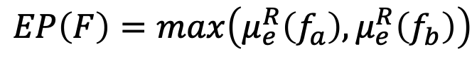
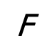
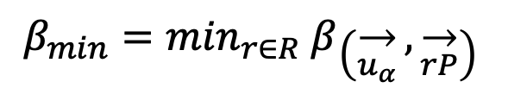

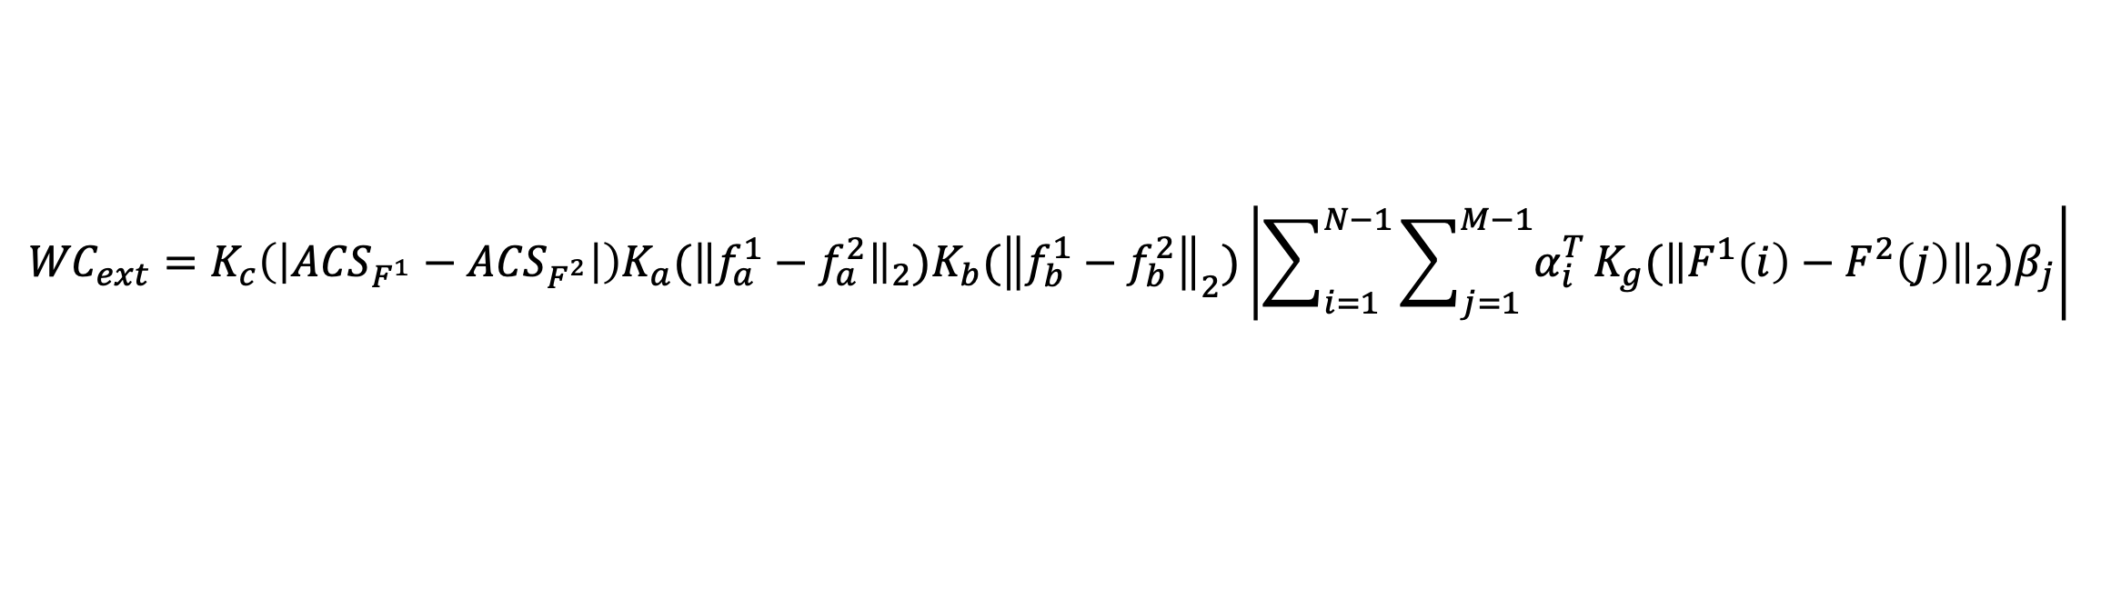
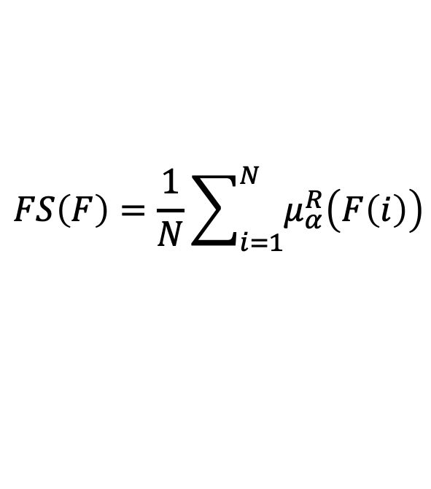
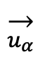

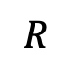
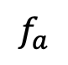
White Matter Multi-Resolution Segmentation Using Fuzzy Set Theory
*Alessandro Delmonte^{1,2}, *Corentin Mercier^{1,3}, Johan Pallud⁴, Isabelle Bloch^{1,2}, Pietro Gori¹
¹LTCI, Télécom ParisTech, Université Paris-Saclay, Paris, France
²IMAG2 Laboratory, Imagine Institute, Paris, France
³LIX, Ecole Polytechnique, Palaiseau, France
⁴Neurosurgery Department, Sainte-Anne Hospital, Paris, France
INTRODUCTION / OBJECTIVE
* equally contributed to this work
Clinicians often describe white matter fiber bundles using spatial indication in relation to known brain references. These descriptions are intrinsically vague, thus needing an appropriate modelling framework. We apply the fuzzy set theory to represent the uncertainty of fibers to belong to a bundle, in terms of spatial, connectivity and trajectory information (e.g. anterior of Amygdala).
White matter fiber bundles are often described using qualitative spatial relationships (e.g. anterior of Amygdala) [1]. We propose to model their inherent vagueness using the theory of fuzzy sets [2]. Furthermore, to cope with the high redundancy of tractograms and ease interpretation, we introduce an interactive navigation and exploration technique based on a multi-resolution representation.
SPATIAL RELATIONS MODELING
$$\frac{\text{1−2}β_{min}}{π}$$
Bundles are defined as logic combinations of spatial (anterior of, …), connectivity (endpoint in, …) and trajectory (crossing, …) relations.
In case of multiple relations, membership functions are combined in a conjunctive way. Finally, a single anatomical coherence score (ACS ) [3] is assigned to each fiber.
Membership functions μ, describing the satisfaction degree to the relations, are evaluated for every point P in the image space. Spatial (FS ) and connectivity (EP ) fuzzy scores are computed for each fiber F (composed by N points and with endpoints f_{a} and f_{b}).
An anatomical coherence score (ACS) [3] is obtained for each fiber/cylinder in a conjunctive way.
$$ACS\left(F\right)=FS\left(F\right)∙EP\left(F\right)$$
Lateral of R in direction 𝛼
ACS 1
ACS 2
ACS 3
All fuzzy spatial relations are combined in a grid containing value scores. An anatomical coherence score (ACS) is obtained for each fiber/cylinder integrating it on the grid.
$$\text{P}$$
1
$$FS\left(F\right)=\frac{1}{N}\sum_{i=1}^{N}{μ_{α}^{R}\left(F\left(i\right)\right)}$$
IFOF
We assign to every fiber an anatomical coherence score (ACS) combining, in a conjunctive way, the satisfaction degrees for all the provided descriptions. Users are able to interactively select the bundles of interest, via an ACS based thresholding operation, with the level of precision that best fit their applications.
Directional
$$R$$
$$β$$
$$\overset{→}{u_{α}}$$
$$μ_{α}^{R}$$
$$μ_{α}^{R}\left(P\right)=max\left(0,g\left(β_{min}\right)\right)$$
$$g\left(β_{min}\right)={1−\frac{kβ_{min}}{π}}$$
0
$$β_{min}=\min_{r∈R} β\left(\overset{→}{u_{α}},\overset{→}{rP}\right)$$
UF
An anatomical coherence score (ACS) is assigned to each fiber combining the fuzzy spatial relations.
Endpoint in R
$$\text{P}$$
1
Connectivity
$$R$$
$$f_{a}$$
$$μ_{e}^{R}$$
$$EP\left(F\right)=max\left(μ_{e}^{R}\left(f_{a}\right),μ_{e}^{R}\left(f_{b}\right)\right)$$
0
ACS
1
$$\text{F}$$
$$μ_{e}^{R}\left(P\right)={\max_{r∈R} e}^{− \frac{{\left\|P−r\right\|}_{2}^{2}}{λ^{2}}}$$
Fig. 1: Fibers of interest can be selected via an ACS
based thresholding operation.
In order to facilitate brain navigation and to add interactivity to the segmentation process, we introduce a white matter multi-resolution representation based on [3]. Fibers are progressively merged together according to their similarity.
0
Reference
We propose a method for white matter segmentation exploiting spatial relations between brain regions. We model the relations inherent incertitude relying on the spatial fuzzy set theory [1,2]. To cope with the high redundancy of tractograms and ease interpretation we introduce an interactive navigation and exploration technique based on a multi-resolution brain fiber representation [3].
MULTI-RESOLUTION REPRESENTATION
White matter multi-resolution [4] technique progressively merges fibers together in generalized cylinders.
FIBERS
Original Bundle
CYLINDERS
Medium Resolution
CYLINDERS
Low Resolution
0.8
ACS 1
ACS
Real-time multi-resolution navigation
Interactive ACS thresholding for segmentation
IFOF
ACS 2
0
Fibers are selected using an extension of the Weighted Currents [5] similarity, containing an ACS term.
We introduce a new term to the similarity measure (WC_{ext}) to take into account the ACS difference between two fibers X and Y, using a gaussian kernel K to regulate this effect:
ACS 1
1
UF
ACS
$${WC}_{ext}=K_{c}\left(\left|{ACS}_{F^{1}}−{ACS}_{F^{2}}\right|\right)K_{a}{\text{(}\left\|f_{a}^{1}−f_{a}^{2}\right\|}_{2}\text{)}K_{b}{\text{(}\left\|f_{b}^{1}−f_{b}^{2}\right\|}_{2}\text{)}\left|\sum_{i=1}^{N−1}{\sum_{j=1}^{M−1}{α_{i}^{T}}}K_{g}{\text{(}\left\|F^{1}\left(i\right)−F^{2}\left(j\right)\right\|}_{2}\text{)}β_{j}\right|$$
April 8-11, 2019
ACS 2
with $K_{c}\left(\left|A−B\right|\right)=1−\left|A−B\right|$, and K_{a} K_{b} K_{g} being Gaussian kernels.
Fig. 2: Multi-resolution fiber bundles visualization
0
To speed up computation, we build an adjacency relationship among fibers using a Delaunay tetrahedralization of their extremities.
Compared to WMQL [4] and manual segmentation, our technique presents less scattered fibers, especially in the areas connecting the temporal and frontal lobe, as shown in the dispersion colormap of figure 3.
RESULTS
Results were validated on 5 unrelated healthy adults subjects from the HCP dataset.
The interactive analysis helped neurosurgeons to better understand the bundles properties and to find the optimal ACS thresholds for IFOF and UF segmentation.
Compared to state-of-the-art methods, a smaller fibers dispersion can be observed.
ACS thresholds were reproducible among different subjects.
[6]
IEEE International Symposium on Biomedical Imaging – 2019 – Venice (IT)
assigns to every point P in the
space the degree of being in direction with respect to R.
FUTURE WORKS
The interactive multi-resolution and thresholding allow for an easier understanding of the bundle as well as a better determination of the threshold at which fibers are all part of it.
We plan to extend the proposed technique to more fiber bundles, implementing additional fuzzy relations and performing statistical analyses.
References
Fig. 3: Tracts dispersion map
[1] S. Wakana et al., “Reproducibility of quantitative tractography methods applied to cerebral white matter”, NeuroImage, vol. 36, no. 3, pp. 630-644, 2007.
[2] I. Bloch, “Fuzzy spatial relationships for image processing and interpretation: a review”, Image and Vision Computing, vol. 23, no. 2, pp. 89-110, 2005.
[3] A. Delmonte et al., “Segmentation of White Matter Tractograms Using Fuzzy Spatial Relations”, in Organization for Human Brain Mapping (OHBM), Singapore, 2018.
[4] C. Mercier et al., “Progressive and Efficient Multi-Resolution Representations for Brain Tractograms”, in EG VCBM, 2018.
[5] P. Gori et al., “Parsimonious Approximation of Streamline Trajectories in White Matter Fiber Bundles,” IEEE TMI, vol. 35, no. 12, pp. 2609-2619, 2016.
[6] D. Wassermann et al., “The white matter query language: a novel approach for describing human white matter anatomy,” Brain Structure and Function, vol. 221, no. 9, pp. 4705-4721, 2016.
Poster n°582
Contacts:
alessandro.delmonte@institutimagine.org
corentin.mercier@telecom-paristech.fr
https://github.com/CorentinMercier/FBTS
Real-time and interactive:
Navigation
Multi-resolution
ACS thresholding

